Slide 1


Natural language processing (NLP) ???
Applications

Slide 2
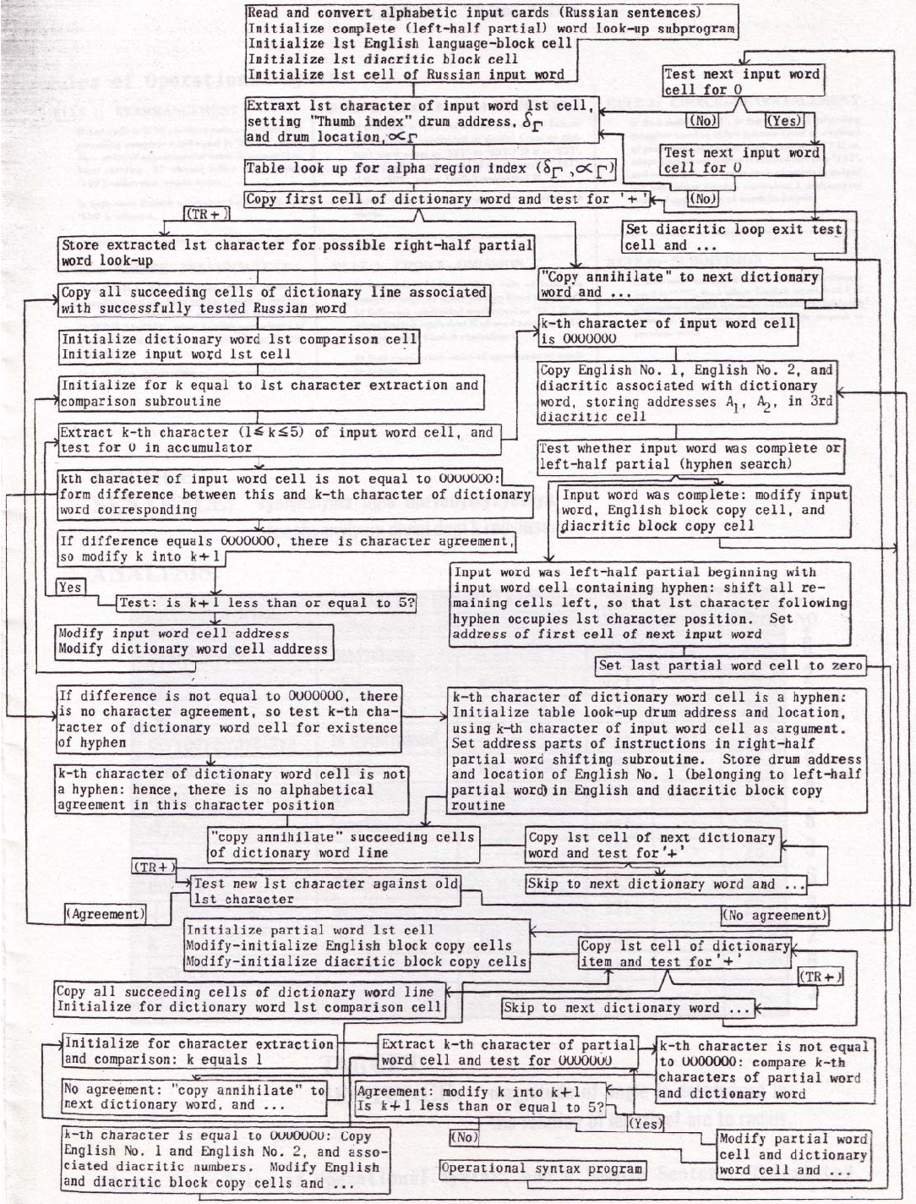
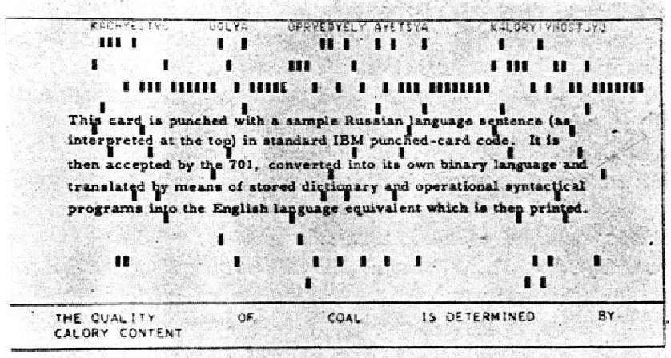
1950s: The Georgetown experiment
fully automatic translation of more than sixty Russian sentences into English.

Slide 3
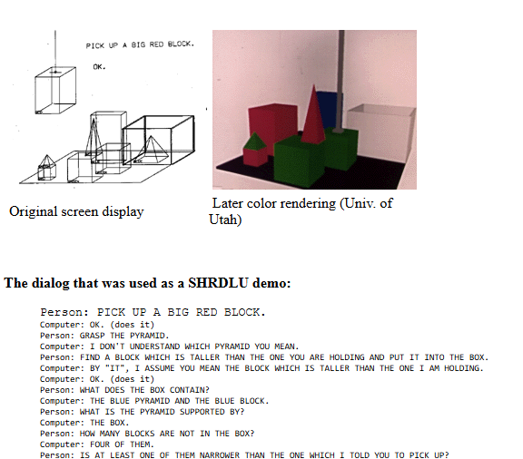
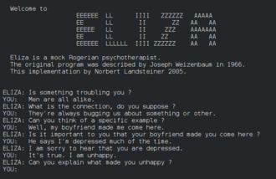
1960s:
ELIZA, a simulation of a Rogerian psychotherapist, written by Joseph Weizenbaum between 1964 and 1966.
SHRDLU, a natural language system working in restricted "blocks worlds"

Slide 4
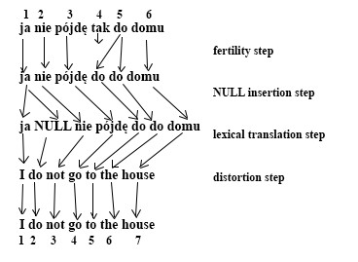
1990s: Many of the notable early successes in statistical methods in NLP occurred in the field of machine translation, due especially to work at IBM Research, such as IBM alignment models.
The original work on statistical machine translation at IBM proposed five models, and a model 6 was proposed later. The sequence of the six models can be summarized as:
Model 1: lexical translation
Model 2: additional absolute alignment model
Model 3: extra fertility model
Model 4: added relative alignment model
Model 5: fixed deficiency problem.
Model 6: Model 4 combined with a HMM alignment model in a log linear way

Slide 5
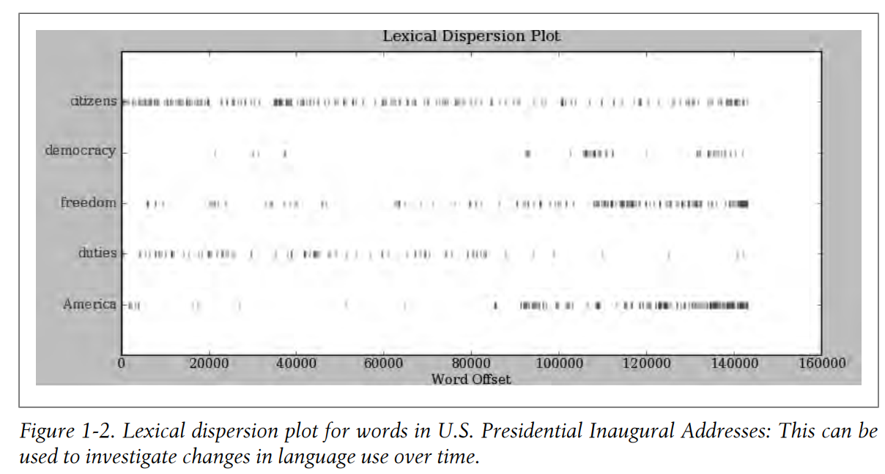
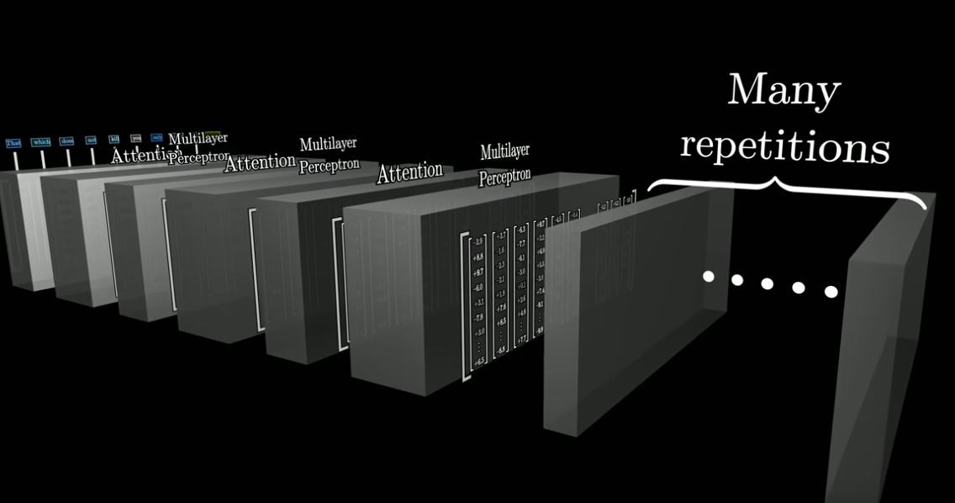
Symbolic NLP (1950s – early 1990s)
Statistical NLP (1990s–2010s)
Neural NLP (present)
Given a collection of rules (e.g., a Chinese phrasebook, with questions and matching answers), the computer emulates natural language understanding (or other NLP tasks) by applying those rules to the data it confronts.
application of neural network models to understand, interpret, and generate human language.
use of statistical methods and probabilistic models to analyze, understand, and generate human language.

Slide 6
Natural language processing (NLP) ???

Slide 7
Natural language processing (NLP) ???
Natural language processing (NLP) - to process data encoded in natural language and is thus closely related to information retrieval, knowledge representation and computational linguistics, a subfield of linguistics. Typically data is collected in text corpora, using either rule-based, statistical or neural-based approaches in machine learning and deep learning.

Slide 8
What is applications of
Natural language processing (NLP) ???

Slide 9
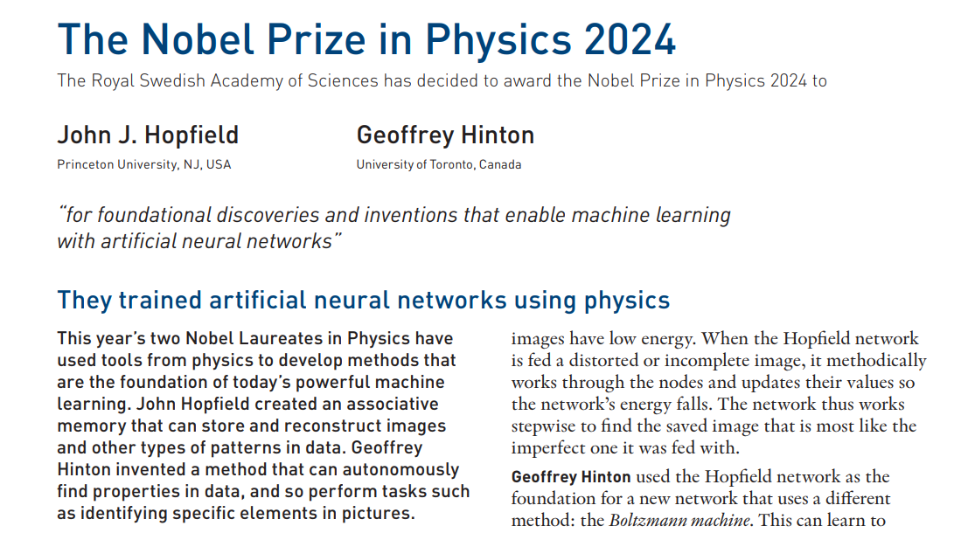

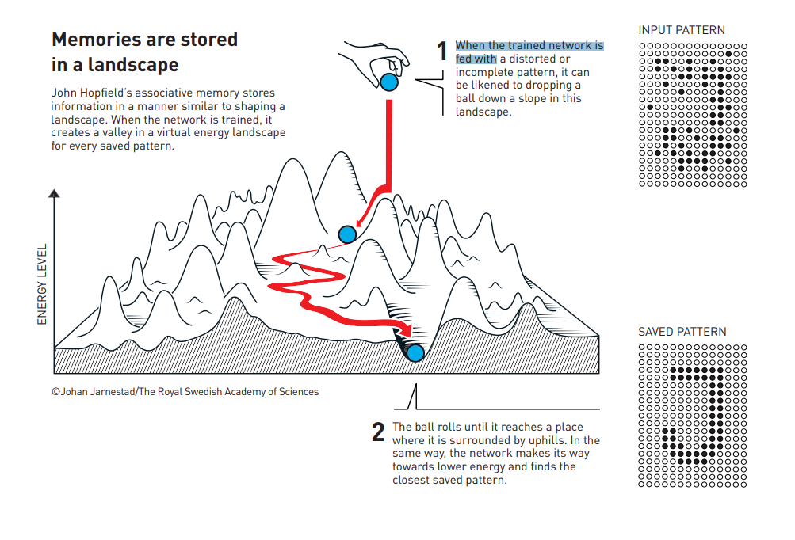
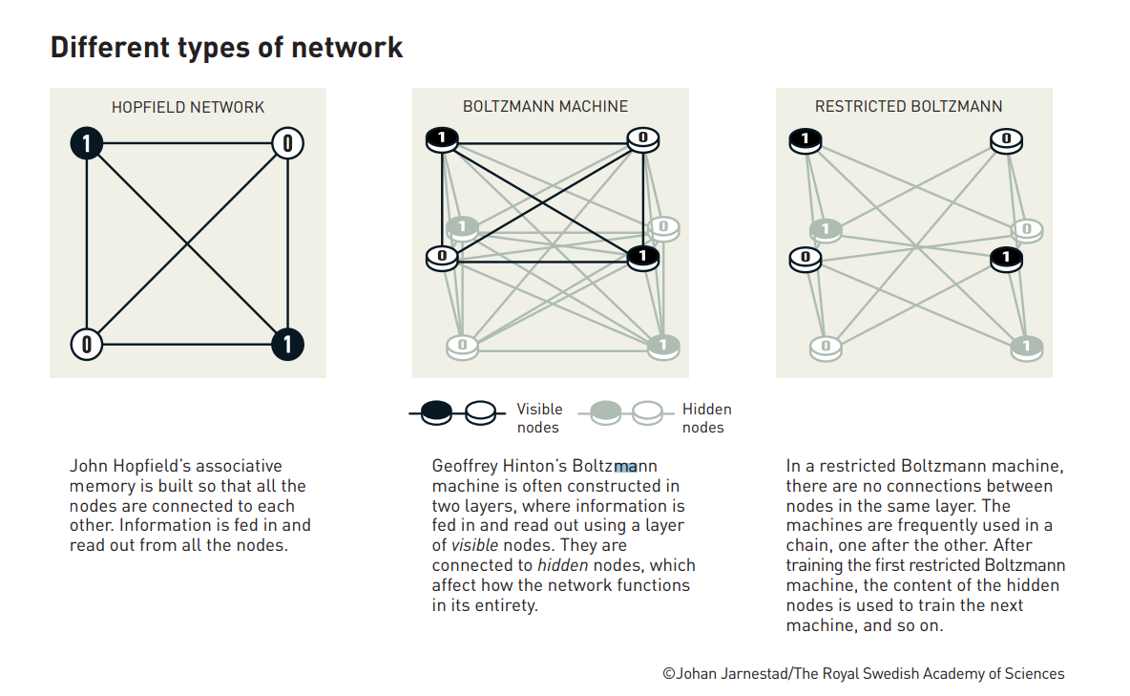

Slide 10



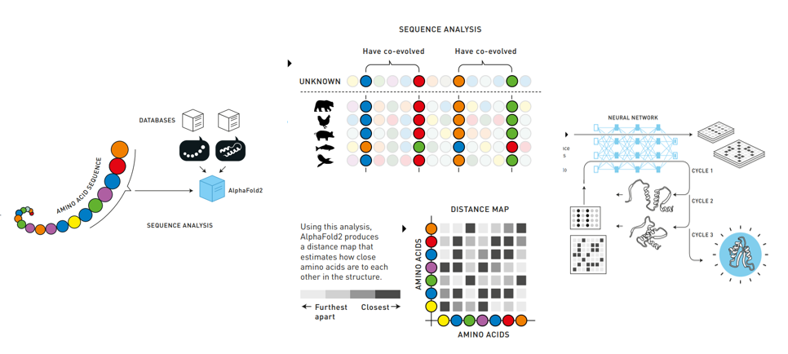

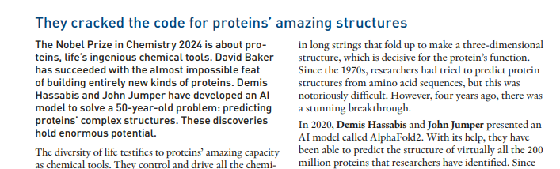

Slide 11
Applications
Applications material science
Machine Translation: Automatically translating text from one language to another.
Sentiment Analysis: Determining the sentiment expressed in a piece of text.
Text Summarization: Generating concise summaries of longer documents.
Question Answering: Providing accurate answers to user queries based on a given context.
Chatbots and Virtual Assistants: Enabling more natural and context-aware interactions with users.
Literature Mining and Knowledge Extraction
Material Property Prediction
Patent Analysis
Text-Based Material Discovery
Interactive Textbooks

